Slide 1
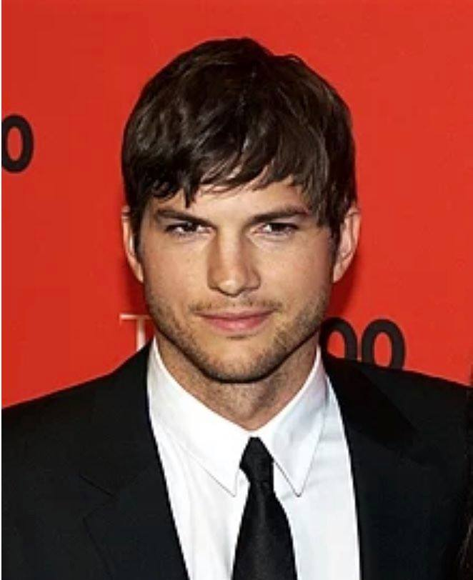
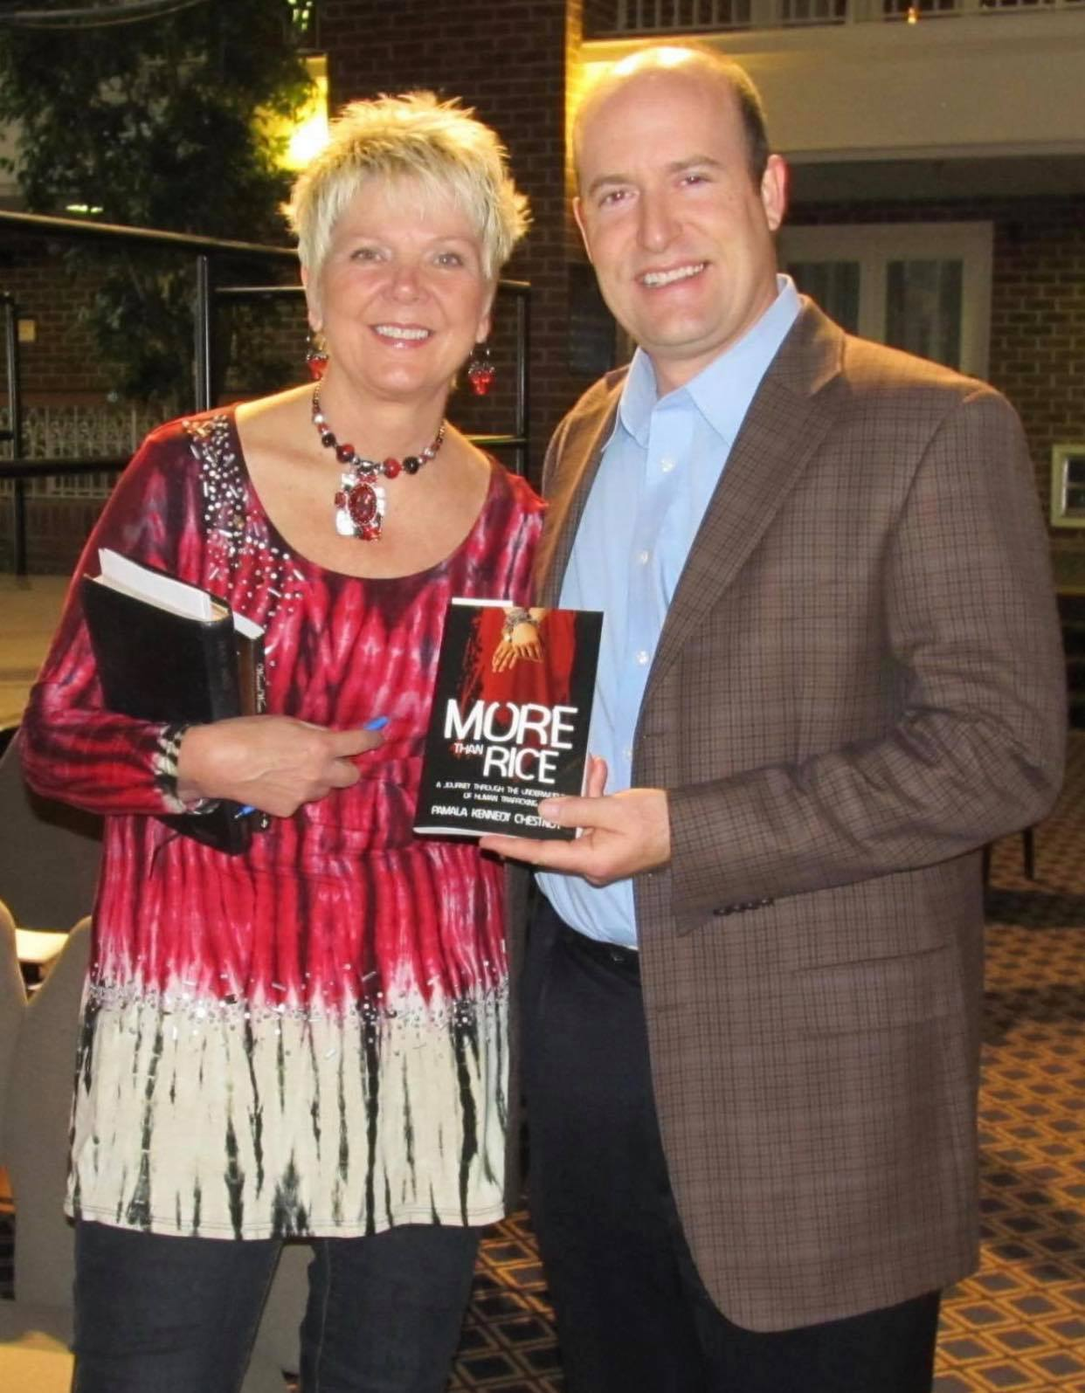
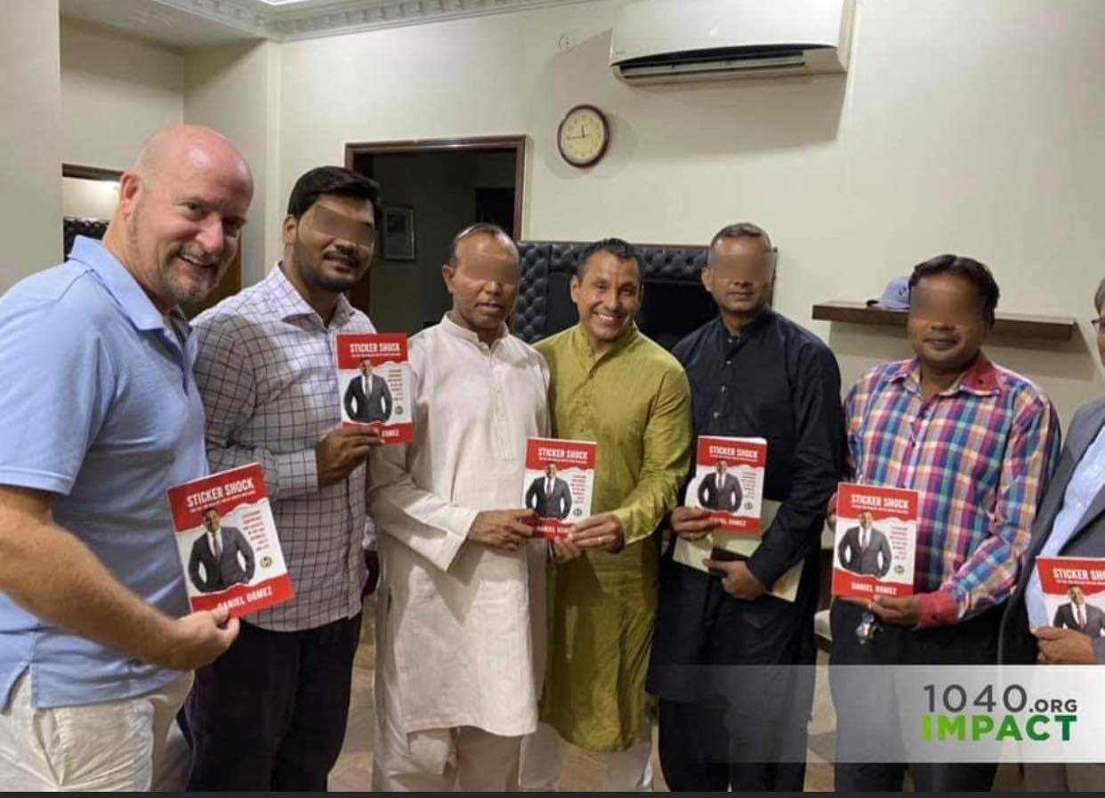
Finding Your Voice
I’m just a nerd kid from OK with my library card maxed out.
text BOOK to 1-918-955-3227

Slide 2
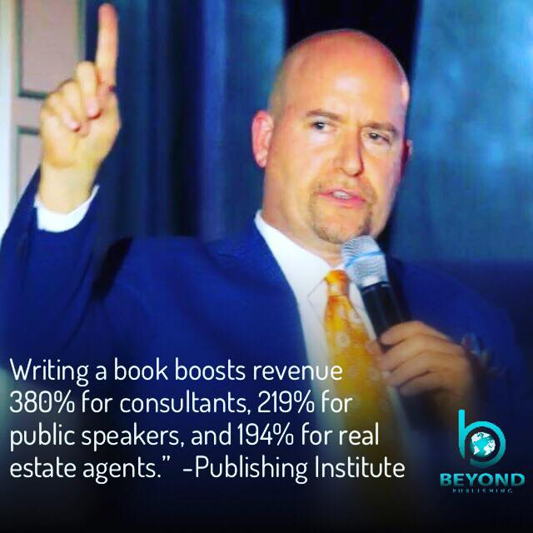

Slide 3
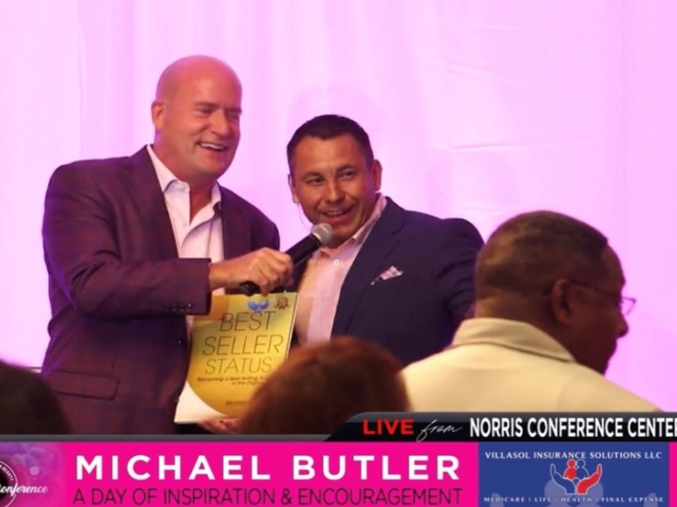
BestSellerStatus.com
WriteBook60Days.com
text BOOK to 1-918-955-3227

Slide 5
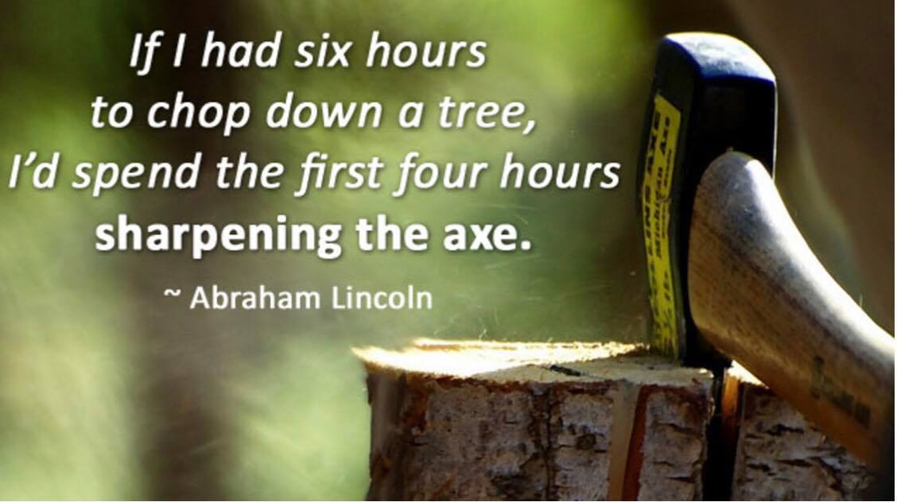
or text BOOK to 1-918-955-3227

Slide 6
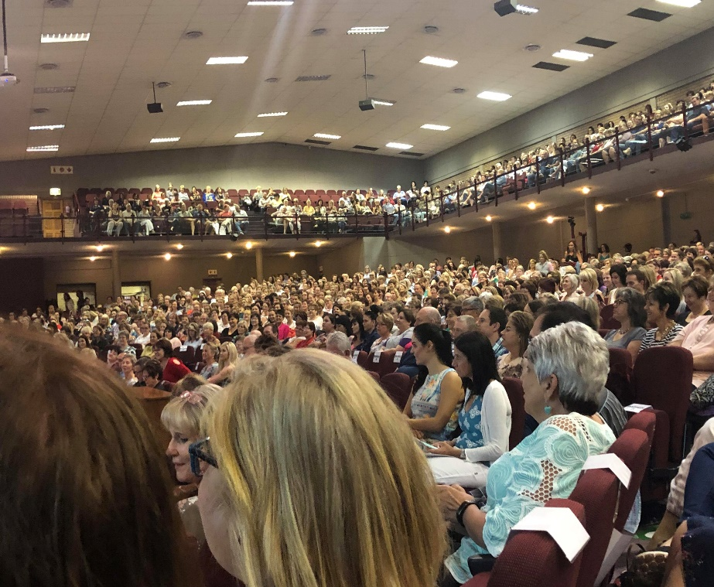
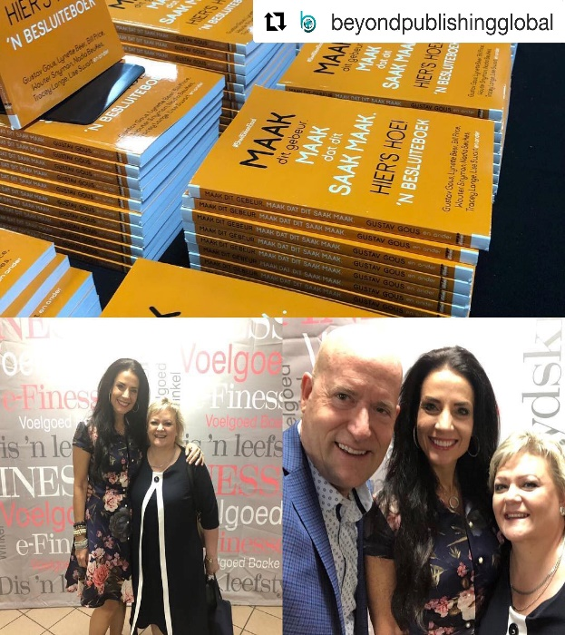
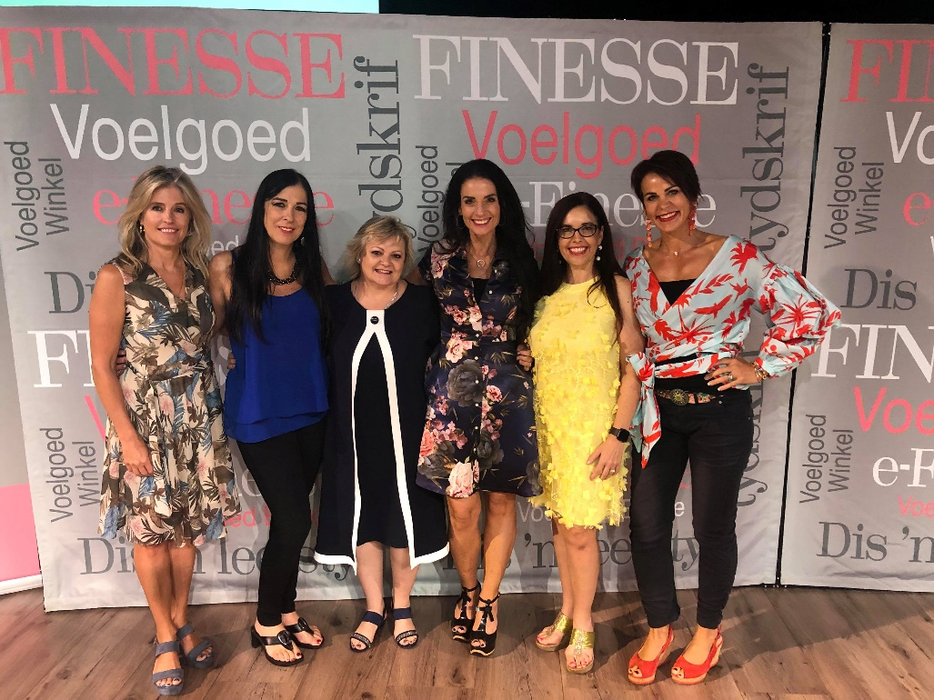
76% of books in English are bought and read
outside of the USA

Slide 7
Writing the book is only 33% of it!

Slide 8
BestSellerStatus.com
WriteBook60Days.com
text BOOK to 1-918-955-3227

Slide 10
Global Publishing/Distribution
$250 Copyright Registration $450 ISBN Assignment for Perfect Bound Book, ebook and hardcover $375 Bar Code & Library of Congress Control Number $650 Custom Print Book Interior Format Design includes eBook Interior Layout and Design $150 Amazon “LOOK INSIDE” feature & Barnes and Noble “READ SAMPLE” $899 Booksellers Return Program (One-time insurance policy Author NEVER pays for returns) $500 E-Book Conversion E-Pub3 $625 PRINT File Submission – soft cover, ebook and hardcover “in the system” to hundreds of platforms $698 Includes one-time audio file upload & optimization to Amazon ACX, Audible & iTunes
$4,597 Publishing Total
$1,350 Professional Book Cover design
$1,250 Amazon Best-Seller
$750 Professional Line Edit $7,947 Total Investment
-$4,950 Sticker Shock Promo BeyondBookDeal.com
$2,997 One-Time Author investment FRI/SAT ONLY (3 pays of 1,200 or 2 payments of $1,600)

